Slide 1
ASD(ASC) and ADHD
Val Harpin
September 2019.

Slide 2

Why is it good to know about ADHD?

Slide 3
DSM IV, 1994
ASD diagnosis meant should not diagnose ADHD
Clinicians and families recognised that this was wrong
NICE, SIGN and then DSM 5 confirm that ASD and ADHD co-exist

Slide 4
Neurodevelopmental Disorders
DSM 5 (2013):
Intellectual disability
Communication Disorders
Autism Spectrum Disorder
ADHD
Specific Learning Disorder
Motor Disorders
DCD
tics and Tourette’s,
stereotyped movements

Slide 5
Follow same structure of criteria setting:
Onset in developmental period
Skills below that expected for age
Impairment in function essential
Exclusions apply

Slide 6
ASD
1% of childhood population (Baird et al, 2006)
ADHD
3 to 5% of school-age children (NICE 2008)

Slide 7
COMORBIDITY
Swedish school-age children
ADHD
ADHD
40%
Reading/ writing
disorder
60%
Oppositional defiant disorder
(ODD)
13%
Learning
Disability
33%
Tic
47%
Developmental coordination disorder
7%
Asperger’s
Mood and anxiety disorders not included
Fig 1. Comorbidity in ADHD.
Kadesjö & Gillberg 2001
Notes:
Educational intent:
to further illustrate overlap of comorbidities
SPEAKERS’ NOTES
The study examined patterns of comorbid and associated problems in a total population sample of children with and without DSM-III-R ADHD.
It showed that 87% of children meeting full criteria for ADHD (3.7% of the population) had one or more — and 67% at least two — comorbid diagnoses. The most common comorbidities were oppositional defiant disorder and developmental coordination disorder.
The study concluded that pure ADHD is rare even in a general population sample.

Slide 8
How many children have autism?
A new US government survey of parents suggests that 1 in 45 children, ages 3 through 17, have been diagnosed with autism spectrum disorder (ASD).
Science ...https://www.autismspeaks.org/.../new-government-survey-pegs-autism-prevalence-1-45

Slide 9
Individuals born in Sweden between 1987 and 2006
Overall and sex-specific prevalence of ASD, ADHD and
comorbid cases in the population under study (n=1 899 654)
Overall Males Females
ASD 28 468 (1.50%) 19 734 (2.03%) 8 734 (0.94%)
ADHD 82 398 (4.34%) 54 759 (5.63%) 27 639 (2.98%)
ADHD 13 793 (0.73%) 9 805 (1.01%) 3 988 (0.43%)
+ ASD
Ghirardi, et al, 2017.

Slide 10
Which means:
48% of those with ASD also had ADHD
17% of those with ADHD had ASD
WOW!

Slide 11
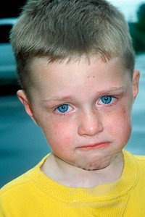
Why does it matter?
Children with ASD and ADHD symptoms scored significantly lower in all areas of life quality (social, communication, etc.) and functioning (school, physical, emotional, etc.) compared to children with ASD
alone
Only 11% were receiving
medical treatment for their ADHD

Slide 12
ADHD symptoms delay
ASD diagnosis
1 in 5 children diagnosed with autism had an earlier diagnosis of ADHD.
Children initially diagnosed with ADHD received their autism diagnosis 3 yrs later
Children with ADHD were nearly 30 x more likely to receive their autism diagnosis after age 6.
The delay in diagnosis occurred regardless of the severity of ASD symptoms.
Miodovnik et al, Pediatrics 2015

Slide 13

Why do they coexist?
Is it just chance?

Slide 14
Risk Factors:
Genetic:
Twin studies suggest 50 -70% of
covariance of ASD and ADHD is due
to shared additive genetic factors
(Reiersen et al, 2008)
Other biological factors:
e.g. Preterm birth
Maternal diabetes
Pre-eclampsia
Psychosocial:
e.g. Romanian orphanages

Slide 15
What is ADHD?
ADHD stands for Attention Deficit Hyperactivity Disorder which is a recognised medical condition with specific symptoms¹
ADHD is a behavioural disorder where the brain grows and works in a different way from those not affected¹
Children with ADHD have functional impairment across multiple settings including home, school and peer relationships
If not managed correctly, a child with ADHD can make it
difficult for teachers to be the sort of teacher they want
to be; a different approach is sometimes needed
References:
1. National Institute of Clinical Excellence Full Guidance – Attention deficit hyperactivity disorder.
Diagnosis and management of ADHD in children, young people and adults, March 2009.
Notes:
Attention Deficit Hyperactivity Disorder is a real disorder with real consequences for the child affected and their family
Children with ADHD cannot help it. Their brain grows and works in a different
way from those not affected
If a child has problems at home, at school and with friends, it is possible they may have ADHD
Many children can be careless, distracted or react too suddenly and thoughtlessly. Children with ADHD do all of these things so that the temptation is to think that commonsense teaching will suffice. But it doesn’t, they need a different approach. Why is that?
References:
1. National Institute for Clinical Excellence. Full Guidance – Attention deficit hyperactivity disorder: Diagnosis and management of ADHD in children, young people and adults, March 2009

Slide 16
Core symptoms
Inattention
Hyperactivity
Impulsivity
These symptoms occur in every child from time to time but when they are persistent and impact on daily functions, more investigation is needed
Notes:
The three core symptoms of ADHD are inattention, impulsivity and hyperactivity when they are persistent and impact on daily functions.
We will look in turn at the behaviours that children exhibit as a result of these symptoms but before we do, in your experience, what behaviour traits do you recognise as being caused by ADHD?
References:
1. American Psychiatric Association. Diagnostic and Statistical Manual of Psychiatric Disorders DSM-IV-TR (2009)

Slide 17

What are the signs?
Notes:
Ask group to share signs and symptoms they recognise as ADHD traits in children in their school/experience and put them up on flip chart/white board

Slide 18
Inattentive symptoms
Inattentive
Is easily distracted
Does not appear to be listening when spoken
to directly
Has difficulty sustaining attention during activities
Avoids or dislikes tasks requiring sustained mental effort
Is forgetful in daily activities
Finds it difficult to follow through instructions and fails to complete tasks
Finds it difficult to organise tasks and activities
Fails to give close attention to detail/makes careless mistakes
Loses important items
Notes:
Ask group if they recognise any of these symptoms or how they may see them manifested in the classroom
Inattentive symptoms will manifest in different ways. Ask group what signs they can think of that they see in the classroom e.g. Trouble following instructions - tasks not completed, disorganised - messy desk or cluttered book bag, careless - messy, work full of mistakes, not listening/has not heard
References:
1. American Psychiatric Association. Diagnostic and Statistical Manual of Psychiatric Disorders DSM-IV-TR (2009)

Slide 19
Hyperactive symptoms
Hyperactivity
Squirms and fidgets
Cannot remain seated
Runs or climbs excessively in inappropriate situations
Often ‘on the go’ or acts as if ‘driven by a motor’
Talks excessively
Cannot perform leisure activities quietly
Notes:
Ask group if they recognise any of these symptoms or how they may see them manifested in the classroom. Hyperactive symptoms will manifest in different ways. e.g. Difficulty remaining seated and excessive fidgetiness, interrupting during
quiet study
References:
1. American Psychiatric Association. Diagnostic and Statistical Manual of Psychiatric Disorders DSM-IV-TR (2009)

Slide 20
Impulsive symptoms
Impulsivity
Blurts out answers before questions
completed
Has difficulty awaiting turn
Interrupts or intrudes on others
Gets into trouble by mistake
Notes:
Ask group if they recognise any of these symptoms or how they may see them manifested in the classroom. Impulsive symptoms will manifest in different ways. e.g. Answers blurted out before the teacher has a chance to finish the question, comments made out of turn
References:
1. American Psychiatric Association. Diagnostic and Statistical Manual of Psychiatric Disorders DSM-IV-TR (2009)

Slide 21
ADHD or bad behaviour?
To be clinically diagnosed with ADHD a child
has to have:
  Six or more symptoms persisting for at least six
  months to a degree that is maladaptive and inconsistent with developmental level¹
  Some hyperactive-impulsive or inattentive symptoms that caused impairment were present before age
  12
  Some impairment from symptoms is present in two or
  more settings, for example, at school and at home¹
  Clear evidence of significant impairment in
  social and/or school functioning¹
Notes:
To consider whether or not a child may have ADHD, is it not enough for the child to exhibit some of the symptoms we have just looked at.
The factors that need to be taken into consideration are: the number of symptoms; the length of time symptoms are present; when symptoms started; and if symptoms impair home and school life
References:
1. American Psychiatric Association. Diagnostic and Statistical Manual of Psychiatric Disorders DSM-IV-TR (2009)

Slide 22
Classroom behaviours
Flitting from activity to activity
Problems sharing
Difficulties following short instructions
Fidgetting, running around
Constant chattering
Difficult temperament, emotional
Interrupting, calling out

Slide 23
Classroom Behaviour
Difficulties learning songs, the alphabet
Problems completing activities
Lots of accidents, breakages
Exuberance, ‘big’ personalities, fun loving, thrill seeking
Exhausted parents (& teachers!)

Slide 24
Aren’t All Children Like that?
Hyperactive children show the behaviours to a degree which interferes with normal day to day activities, in all settings (home, nursery, school & at play)

Slide 25
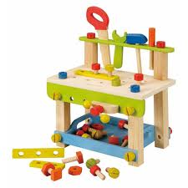
Toolkit.

Slide 26
Diagnosis
Careful history is key:
Is behaviour due to ADHD, ASD or BOTH?
Remember this can change

Slide 27


If a C/YP has ADHD and we wonder about ASD:
Eye contact
Greeting
Facial expression

Slide 28




Clothing?
?
Image?

Slide 29

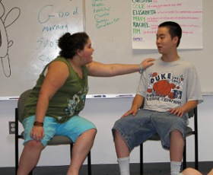
Behaviour
In and out of school
Interaction in clinic

Slide 30




Obsessional Traits:

Slide 31
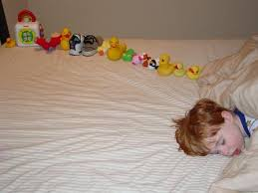

Obsessional traits:
Past history is relevant

Slide 32




Collecting?

Slide 33

Conversation/language?
Topic?
Complexity?
Reciprocal/interest in others?
Humour?
Literality?

Slide 34
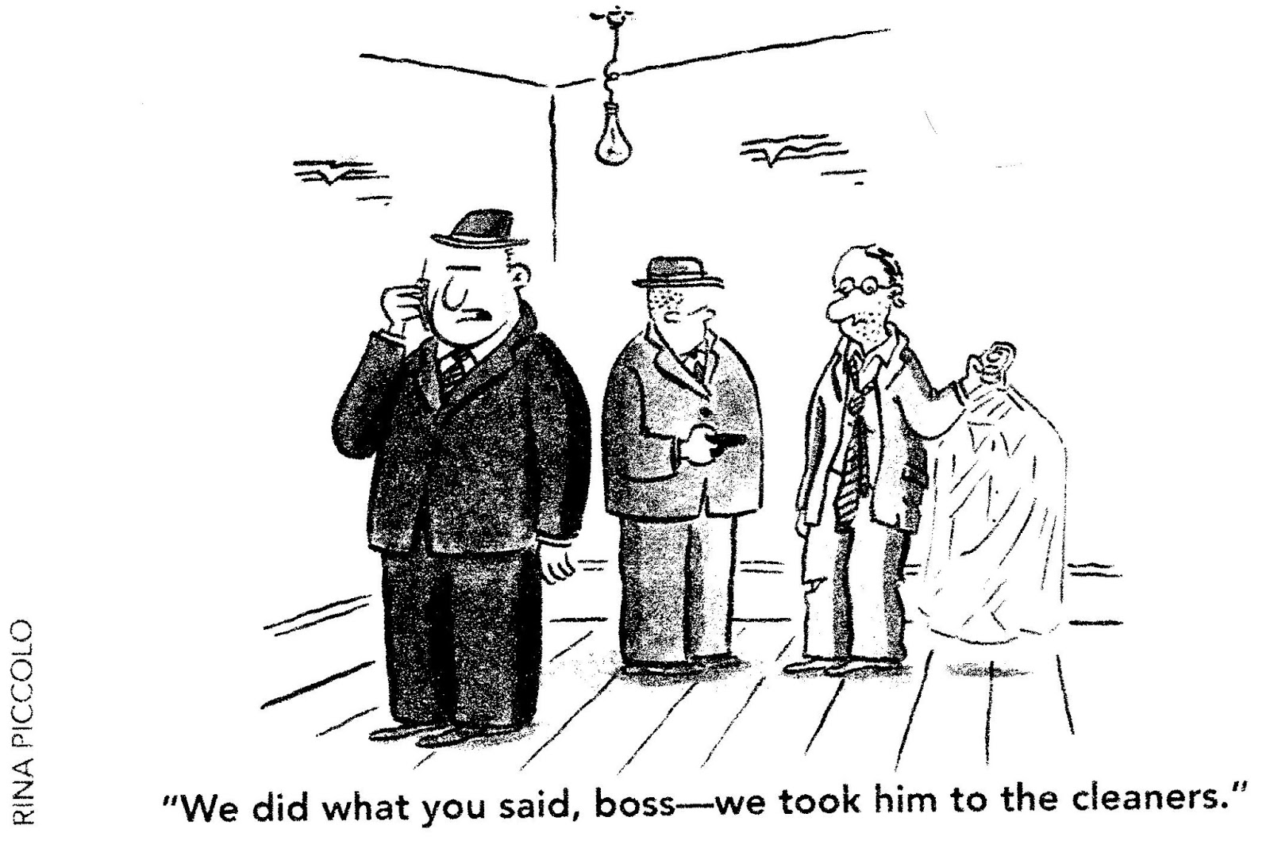
Literal understanding:
‘Pull yourself together’
‘I’m going to lose
my rag with you!’
‘You can go
swimming when this
glass is empty’
‘That’s a bit of a kick
in the teeth’
‘Yeah. Course I’ll go
out with you.’

Slide 35
At initial ADHD assessment.
Understand the information you have gathered
Listen
Ask
Watch
Examine
Look for all possible explanations
Work out what other information you need, if any
If things are not clear what can help make them clearer?

Slide 36

Involving schools and colleges:
When ADHD is diagnosed,
when symptoms change,
when there is transition between schools or from school to college
NICE 2018

Slide 37
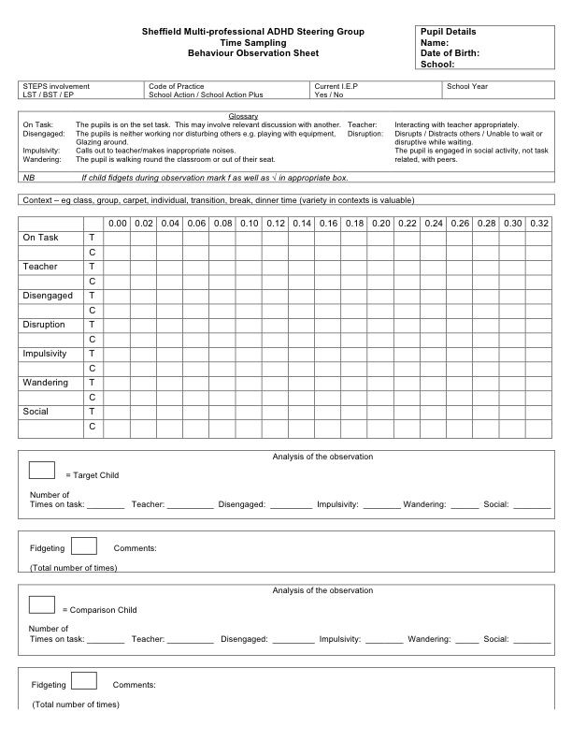
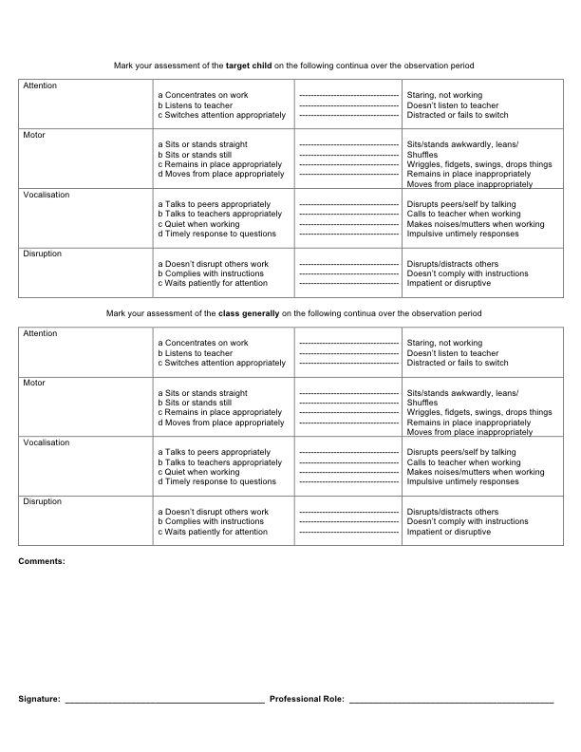
School Observation Checklist.
Comparison with
‘control’ child
Comparison with
whole class

Slide 38

School observation
80% of children with a score of 27 and above had ADHD.
“Although ideally carried out by a skilled observer who is able to interpret the observation qualitatively and may identify additional information e.g. features of comorbid conditions,
our study suggests that a structured scoring system could still be useful in the hands
of less experienced observers
e.g. teaching assistants.
The checklist could be considered
as a screening tool to inform
referrals for full ADHD assessment.”

Slide 39
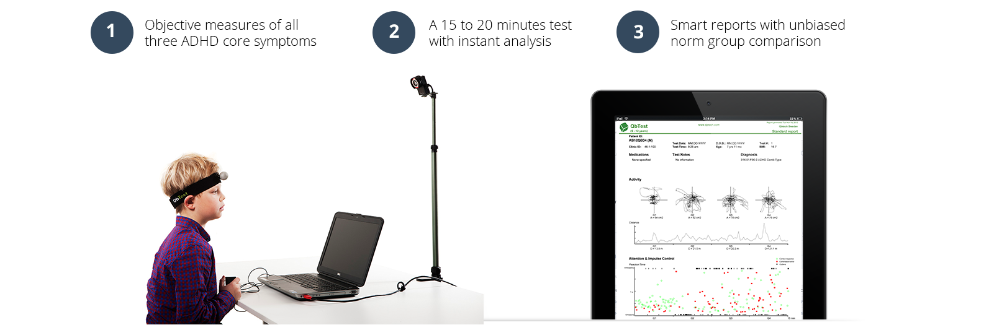
Qb Test

Slide 40

QbTest is now the first objective test cleared by FDA for treatment follow-up of ADHD

Slide 41
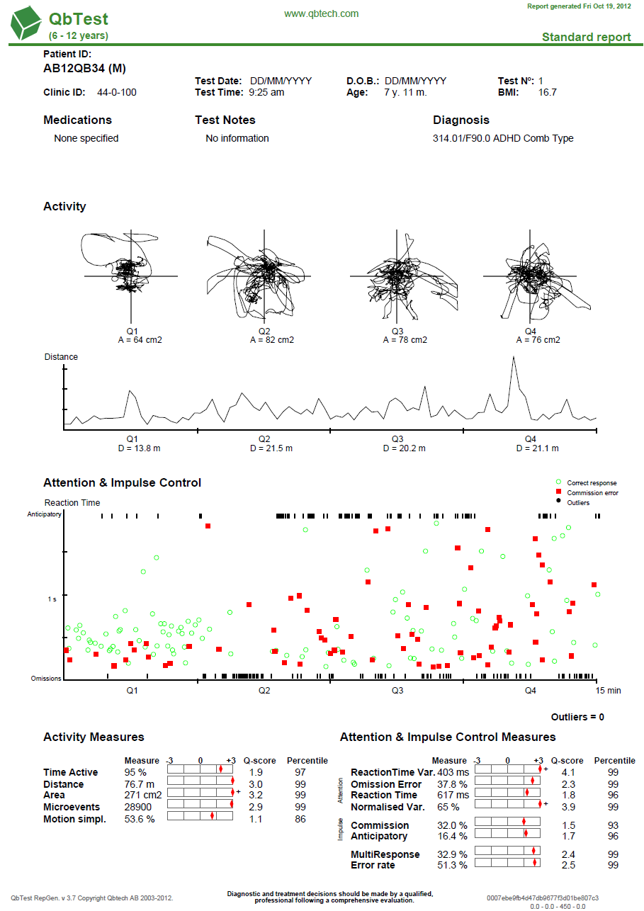
Combined type ADHD 9 year old boy

Slide 42
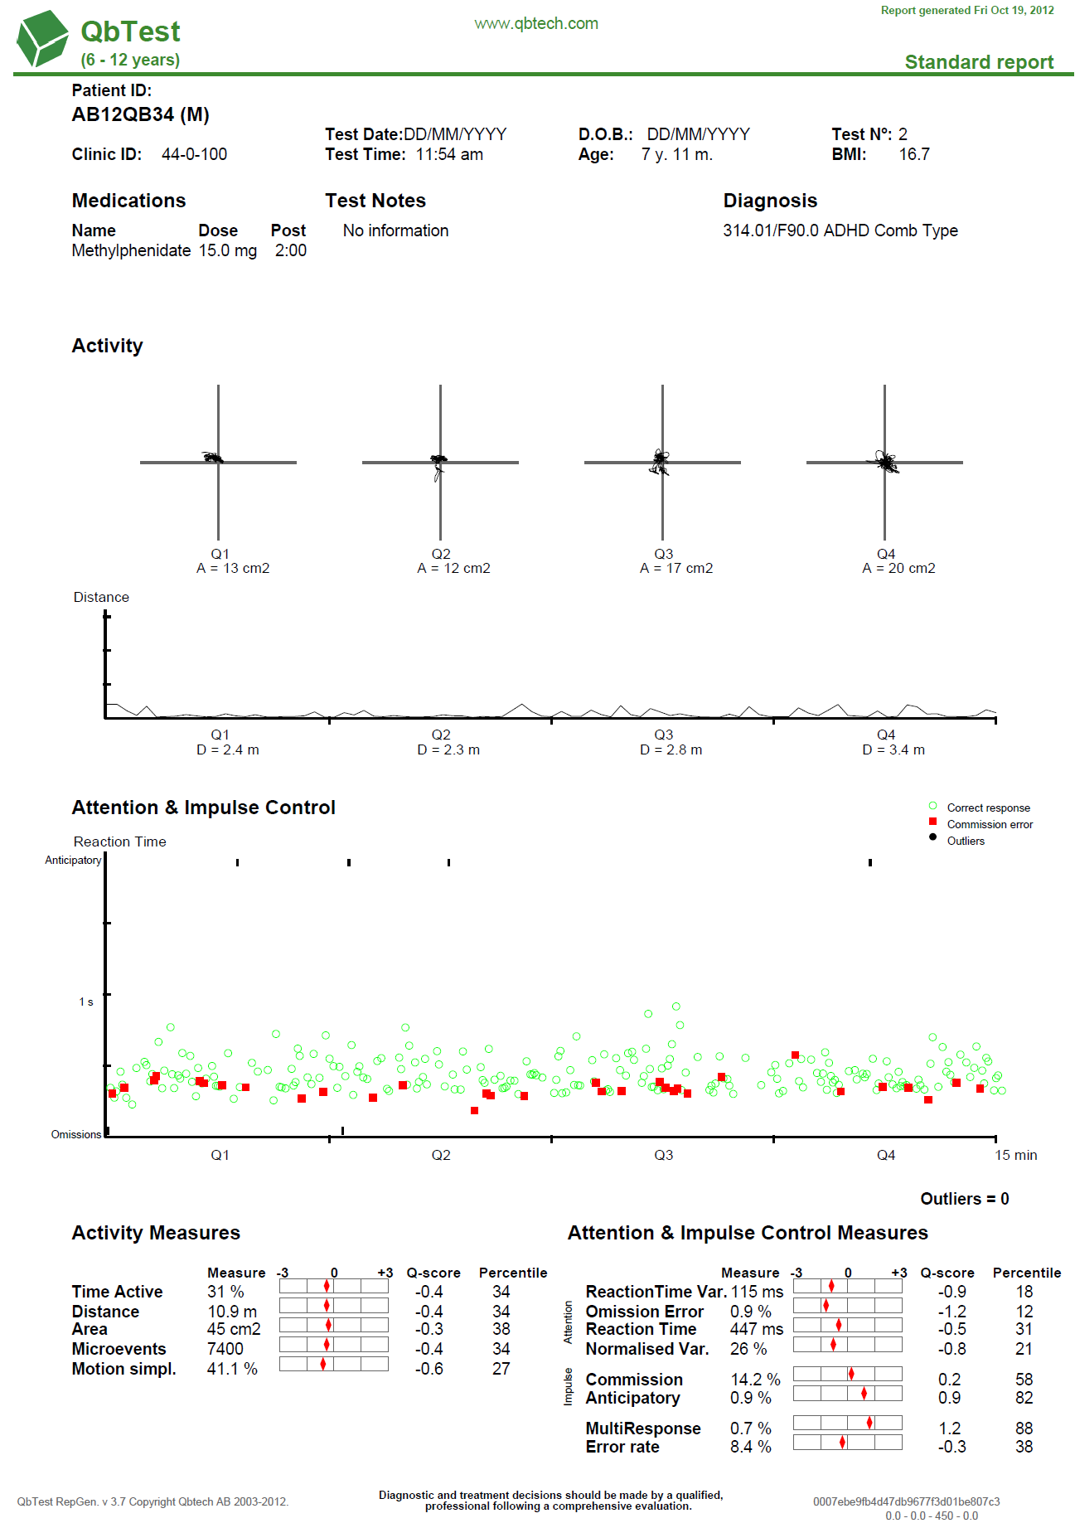
Response to
Stimulant
medication

Slide 43
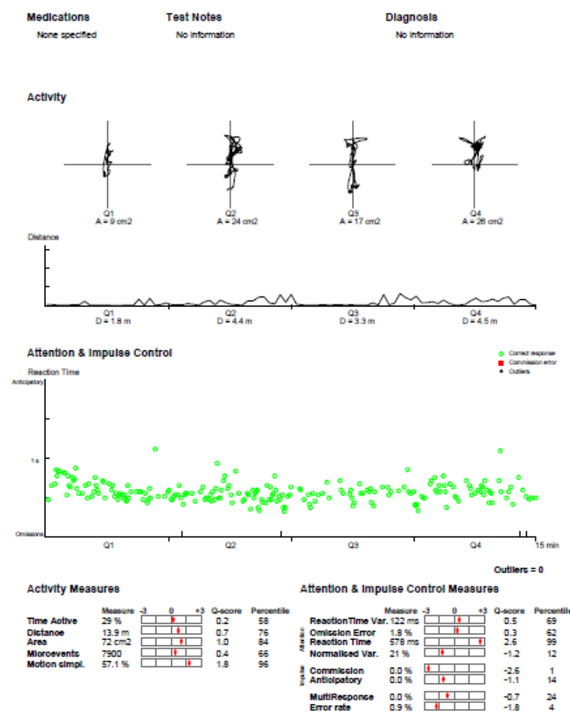
QB report:
Not ADHD.

Slide 44
Impairment?

Slide 45

Assessment of impairment
Impairment of at least moderate clinical +/-
psychosocial significance in >1 domains
Pervasive i.e. in 2+ situations (home/school/work)
NICE, 2008

Slide 46
Childhood domains:
self-care;
travelling independently;
making/keeping friends;
achieving in school;
forming positive relationships in family;
positive self-image,
avoiding criminal activity;
avoiding substance misuse,
emotional states free of excessive
anxiety and unhappiness;
understanding risk
avoiding common hazards

Slide 47
Adult/adolescent domains
Occupational/educational underachievement,
dangerous driving
problems in intimate
relationships (eg excessive
discord and jealousy)

Slide 48

Impairment?
Thanks to Ian Male

Slide 49
Effective management?
:
Notes:
A combination approach is needed in the effective management of a child with ADHD. No one element works well in isolation
References:
1. National Institute for Clinical Excellence. Full Guidance – Attention deficit hyperactivity disorder: Diagnosis and management of ADHD in children, young people and adults, March 2009.

Slide 50

Pre-school Overactivity: Interventions
Notes:
Educational intent:
to describe the psychopathology of ADHD in toddlers
SPEAKERS’ NOTES
There may also be delays in language and motor milestones.

Slide 51
Preschool
Parent training programmes should be offered as first line treatment (BOR 2002, SONUGA-BARKE 2001)
Programmes should be:
Structured with a programme built on principles of social-learning
Include relationship enhancing strategies
Offer 8 to 12 sessions

Slide 52
Preschool
Enable parents to identify their own parenting objectives
Be delivered by appropriately trained facilitators
Adhere to the programme to ensure consistency
Include both parents if feasible
Consider difficulties of access which could exclude families

Slide 53
What Helps?
Understanding
Home/ nursery/Classroom management
CREATIVITY !
ENERGY !

Slide 54
Specific Techniques
Attention & Turn Taking
Visual Memory Games
Auditory Memory Games
Impulse Control / Waiting
Emotional Sensitivity

Slide 55
Effective management for school age children with;
ADHD:
Psychoeducation
Education modification
Behavioural therapy
? Medication
Treating coexisting difficulties
Supporting families
Cross agency working
ASD
Psychoeducation
Education modification
Behavioural therapy
? Medication
Treating coexisting difficulties
Supporting families
Cross agency working
Notes:
A combination approach is needed in the effective management of a child with ADHD. No one element works well in isolation
References:
1. National Institute for Clinical Excellence. Full Guidance – Attention deficit hyperactivity disorder: Diagnosis and management of ADHD in children, young people and adults, March 2009.

Slide 56
Management strategies for children with
ASD+ADHD in school
Includes:
Visual timetables, structure/ routine:
supporting understanding and language development
and giving clarity to what will happen and what is expected
Simple concrete language
Used when you have the child’s attention to reduce misunderstanding
Low stimulation areas:
reducing sensory difficulties
Social stories:
helping the understanding of social interaction in school and beyond

Slide 57
Top ten hints and tips
1. Construct positive relationships
with the members and teachers and
aim to share the same approach.
Good communication and consistency is key

Slide 58
Top ten hints and tips
2 . Allow time for processing of information. For example by reducing the amount of language they have to concentrate on and allow for flexibility in amount of time needed to complete a project

Slide 59
Top ten hints and tips
3.Give an overview of what you want them to do then break it into smaller, prioritised steps.
Children with ADHD have difficulty with planning activities and doing them in the right order so establishing small tasks leading up to a completed project will help

Slide 60
Top ten hints and tips
4. Sit the child close to you and pair them with a calm pupil away from potential distractions. ASD+ADHD children are easily distracted, so where they sit in the classroom can make a difference e.g. away from windows and doors

Slide 61
Top ten hints and tips
5. Provide opportunities to be physically active and try to find a way to allow them to fidget e.g. let them be the one to go and fetch something and allow the use of squeeze balls
6 Explain in advance what's going to happen, especially if different to what they expected.

Slide 62
Top ten hints and tips
7. Promote self esteem by praising them in public for positive behaviour. When necessary discipline them quietly on a one-to-one
8 Keep a chart to track their tasks or their behaviour. Rewards can then be given when they reach their target

Slide 63
Top ten hints and tips
9 Be aware that bullying by other pupils may be a problem.
When things go wrong, it may not always be the fault of the child with ASD+ADHD. Be willing to hear their side of the story
10 Help show them how to make friends and play appropriately with others

Slide 64
Medication

Slide 65
Medication in ASD/ADHD
Does it work?
What are the side effects?
Which is the best medication?

Slide 66

Medication?
Methylphenidate?
Amfetamine?
Guanfacine XR?
Atomoxetine?

Slide 67

Medication Pathways:
Review question:
What is the most clinically and cost-effective sequence of pharmacological treatment for children and young people with ADHD?

Slide 68


Preschool children and medication:
4 studies
Methylphenidate
Risperidone
Recommendation for
behavioural management

Slide 69
Schoolage children:
Offer medication for children and young people with ADHD aged 5 years and over
IF their ADHD symptoms are having a persistent significant impact
in at least one domain of their
everyday life
after environmental modifications.

Slide 70
First-line:
Offer methylphenidate as first-line
pharmacological treatment for
children aged 5 years and over and young
people with ADHD.

Slide 71
Then:
Consider lisdexamfetamine for children aged 5 years and over and young people whose ADHD symptoms are not responding adequately to methylphenidate.
Consider dexamfetamine for children aged 5 years and over and young people whose ADHD symptoms are responding to lisdexamfetamine but who cannot tolerate the longer effect profile.

Slide 72
Then:
Offer atomoxetine or guanfacine if:
• cannot tolerate methylphenidate and lisdexamfetamine,
• symptoms have not responded to separate 6-week trials of lisdexamfetamine and methylphenidate,

Slide 73
Baseline assessment: pre medication
A review of mental health and social circumstances, including:
presence of coexisting mental health and neurodevelopmental conditions
current educational or employment circumstances
risk assessment for substance misuse and drug diversion care needs
A review of physical health, including:
a medical history, taking into account conditions that may be contraindications for specific medicines current medication
height and weight (measured and recorded against the normal range for age, height and sex)
baseline pulse and blood pressure
a cardiovascular assessment
Family history

Slide 74
Comprehensive, holistic shared treatment plan that addresses psychological, behavioural and occupational or educational needs.
Take into account:
• the severity of ADHD symptoms and how these affect or may affect a person’s life
• their goals
• the level of impairment and impact on their everyday life
• their resilience and protective factors
• the relative impact of other neurodevelopmental or mental health conditions.

Slide 75
Coexisting difficulties:
Follow the same pathway for people with ADHD and co-existing conditions
No evidence of worsening co-existing conditions.
‘dearth of evidence’
groups were not distinguished within the analysis or were excluded from trials.
Consensus view:
consider the same medication choices
consider the individual circumstances
slower dose titration
more frequent monitoring.

Slide 76
Use of medication for ADHD in the presence of ASD
Methylphenidate improves ADHD symptoms
Side effects not more common or severe
Santosh PJ, Baird G, Pityaratstian N, Tavare E, Gringras P.

Slide 77
Other ADHD medications and ASD.
Atomoxetine also good in some trials (Harfterkamp et al, 2012) (Harfterkamp et al 2013.)
Prolonged release guanfacine, (Intuniv) a selective alpha 2 agonist, offers an additional choice (Scahill et al 2012)

Slide 78
Follow-up and monitoring
Symptom control
Side effects
Growth
Sleep
Worsening behaviour
Adherence

Slide 79
When behaviour difficulties are severe
Detailed analysis is needed.
What is the child/YP trying to communicate?
e.g. self harming or aggressive behaviour may be prompted by anxiety in which case management of the cause of the anxiety is needed.
Notes:
If ASD and comorbid ADHD are combined with severe behaviour difficulties which challenge those caring for them detailed analysis is needed. Every behaviour has a message and understanding what the child/young person is trying to communicate and the benefit the behaviour has for them underlies a successful behaviour management plan. For example, self harming or aggressive behaviour may be prompted by anxiety in which case management of the cause of the anxiety is needed. In some children/young people if there is no improvement following careful assessment of the behaviour and the use of specific behavioural management, antipsychotic medication e.g. aripiprazole or risperidone may be helpful. Careful monitoring with baseline and follow up blood investigations and ECG is needed. Excessive weight gain is frequently a concern and premedication and follow up dietary advice around healthy eating can be a very useful preventative strategy.

Slide 80

So? If definite ADHD diagnosis in C/YP with ASD and no contraindication:
Try behaviour management
Consider medication
Start low, go slow
Set realistic goals
Monitor
Monitor
Monitor!

Slide 81
Developmental Coordination Disorder.
20 to 50 % of individuals with ADHD
http://www.eacd.org/publications.php

Slide 82
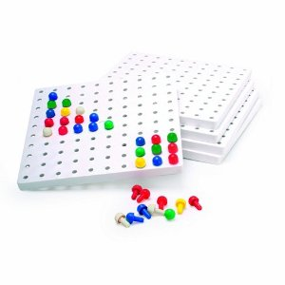
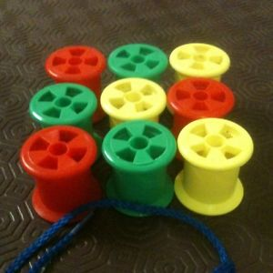

Simple screens: for motor problems

Slide 83

Spotty dogs.

Slide 84
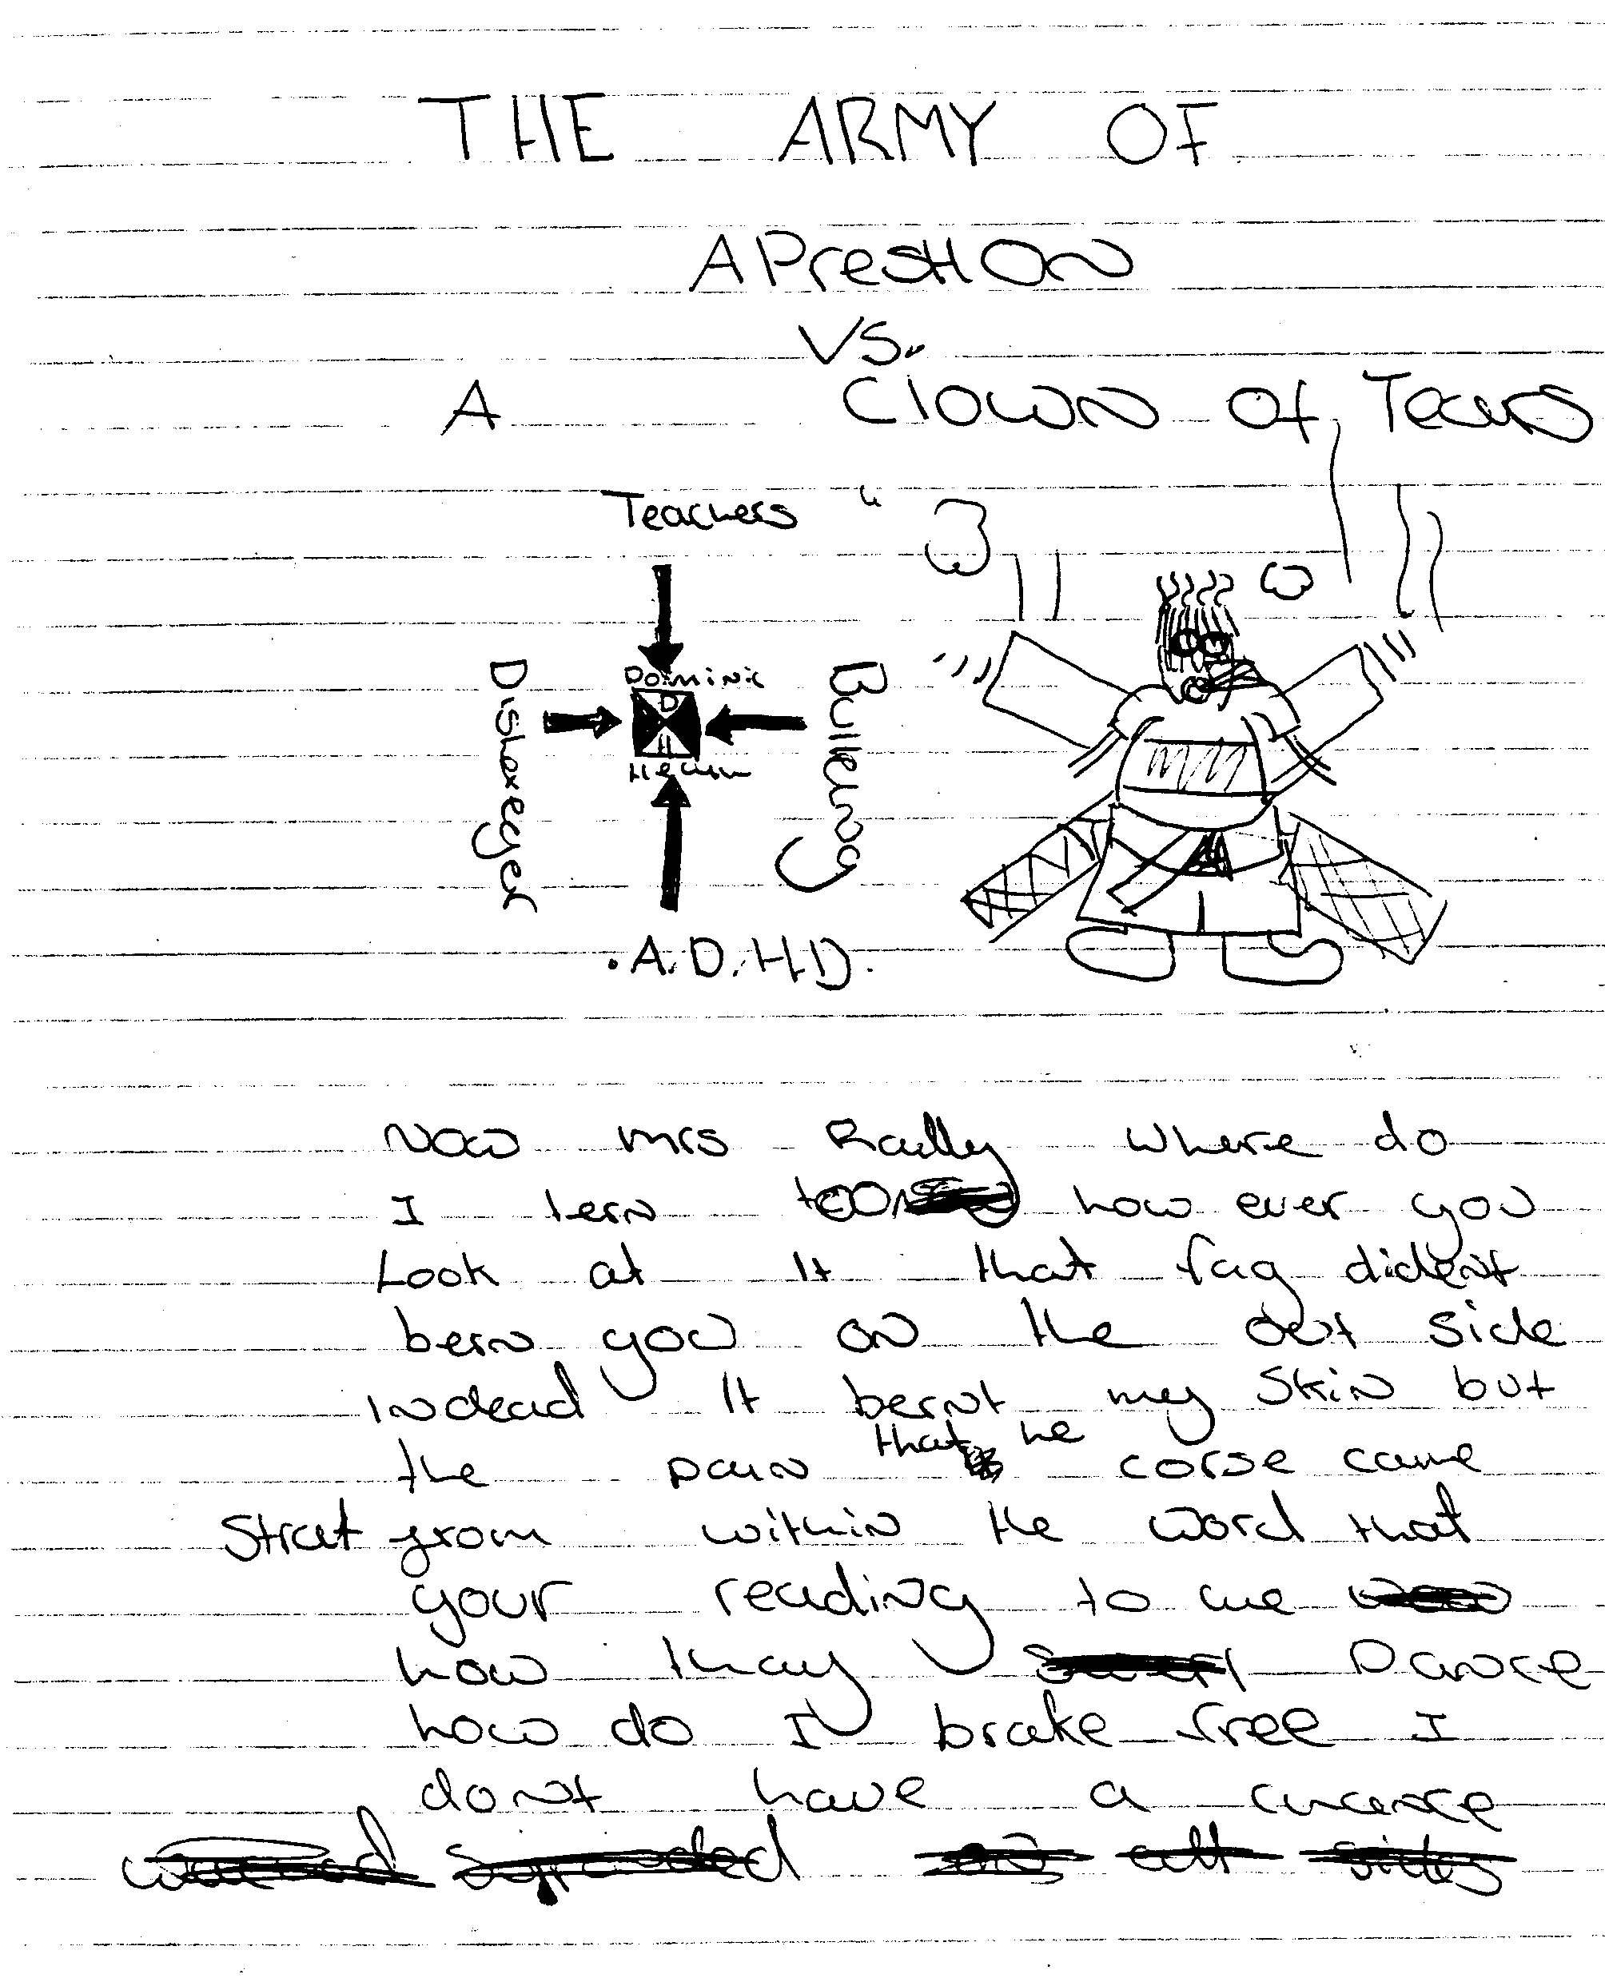
Writing
The effects of methylphenidate on the handwriting of children with minimal brain dysfunction .Lerer RJ,et al . J Peds 1977
Effects of methylphenidate on quality of life in children with both developmental coordination disorder and ADHD. Flapper BC et al,
Dev Med Child Neurol. 2008
.Fine motor skills and effects of methylphenidate in children with attention-deficit-hyperactivity disorder and developmental coordination disorder.Flapper et al, Dev Med 2006.

Slide 85
Anxiety Disorders
(10-40% in ADHD > in those with ASD+ADHD)
Related in part to poor emotion regulation
Anxiety disorders more likely in parents and family
Interview child/young person not just carer
Treat most severe problem first
Ensure ASD strategies in place
Notes:
Two RCTs have looked at the treatment of ADHD and comorbid anxiety disorder.
• In a four-month trial of MPH , the presence of anxiety did not influence the response to the medication or the numbers of adverse events.
• In a 12-week trial of ATX in the treatment of ADHD and comorbid anxiety there was a reduction in symptoms of both ADHD and anxiety, but ATX treatment was associated with significantly more reports of decreased appetite and weight loss compared to placebo.

Slide 86
Sleep disorders (30-56%)
Mainly delayed onset and greater night waking leading to shorter sleep time
More activity during sleep
May exacerbate attention problems in school

Slide 87
Management
General sleep hygiene
Melatonin
Monitor role of medication (diary)

Slide 88

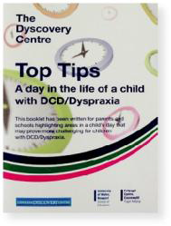



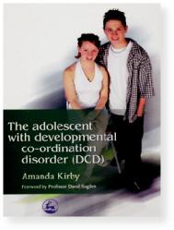
Resources:
http:/www.boxofideas.org/ideas
http://www.autism.org.uk
National Autistic society:

Slide 89

BUT:
Children and Young people don’t often fit into neat boxes!

Slide 90
Why treatment is important:
‘I wanted to let you know we are 3 days into meds and it has literally revolutionised our life. She has just spent 20 minutes looking through recipe books for a pudding we can make to take to a friend’s house. And she is engaging so much more in responsive conversation, following instructions and her entire body is stiller. She has read books with me without moving once.
I am astounded at the impact.’
Message left by the mother of a girl with ADHD, ASD and
learning disability after starting LA methylphenidate

Slide 91

And:
Dear Val,
……. ‘I have finished my degree and got a really good job in Italy.
How can I get my concerta here?
I need it to manage
my job.’

Slide 92
Specific Techniques
Overactive children need different teaching (& parenting) approaches
Use strategies that target the core underlying difficulties (overactivity, inattention, impulsivity, working memory)
Exaggerated emotion, action & colour work well ie the more ridiculous the better!

Slide 93
Attention & Turn Taking
Recruit attention, clear non-verbal signals
Short instructions
Eye contact “Good looking”
Repeat instructions back
Simple card games SNAP (limited cards)
Extending play using language & song (!)
Snack time (P.O.P)
Visual cues, eg carpet spot, listening rabbit, story bear, Tidy Up Time, Snack Time, Story Time cards (P.O.P)

Slide 94
Auditory Memory Games
Simon Says …..
I went to market ….
I Spy
Repeating simple rhythms eg drum beats
Scaffold
What can they do – extend- consolidate - rescope

Slide 95
Impulse Control / Waiting
Visual cues – countdowns – timers
Delayed rewards
Ready…, steady…, go activities (1.., 2..,3..)
Sleeping lions
Hiding in the ‘cave’ (P.O.P)
Key game
Stop watch challenge !

Slide 96
Emotional Sensitivity
Focus on positives (“good looking” & thumbs up)
Eye contact for positives (not just negatives)
‘We’ commands to reduce individual focus
Choices to increase sense of control
1:1 quiet / calm down time with adult support to model calming techniques & discuss alternatives
Time out for hurting & destructive behaviour (but ideally above)

Slide 97

Thank you.

